Slide 1
Data Visualizations

Slide 2
Proportions

Slide 3
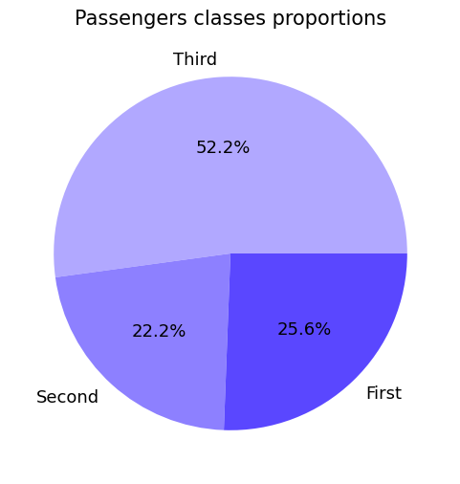
Pie chart

Slide 4
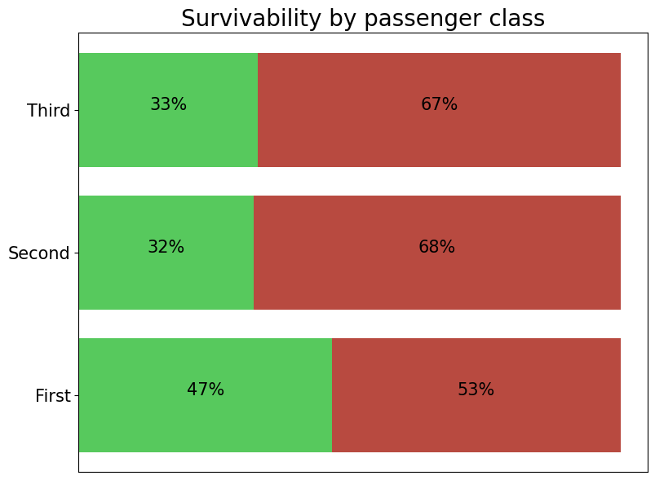
Bar chart

Slide 5
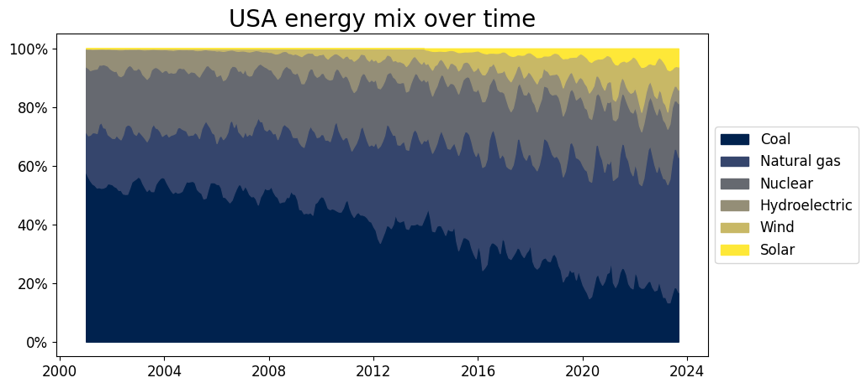
Stacked density plot

Slide 6
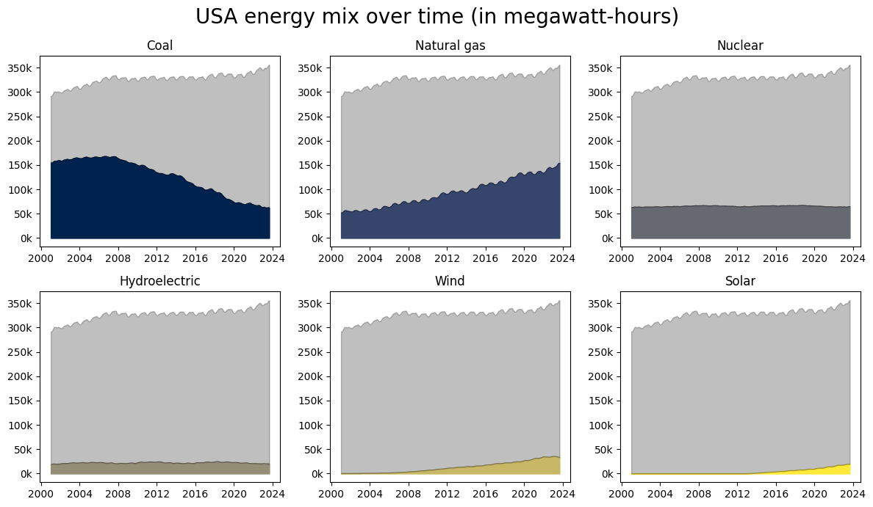
Stacked density plot

Slide 7
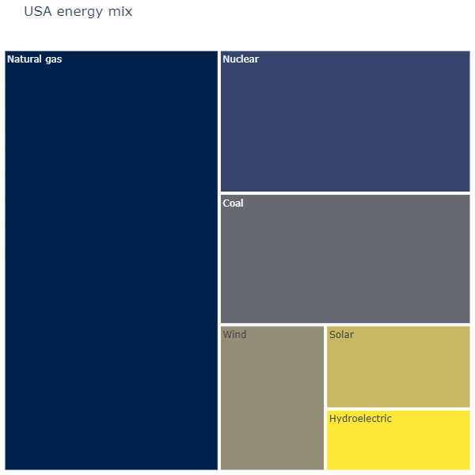
Treemap

Slide 8
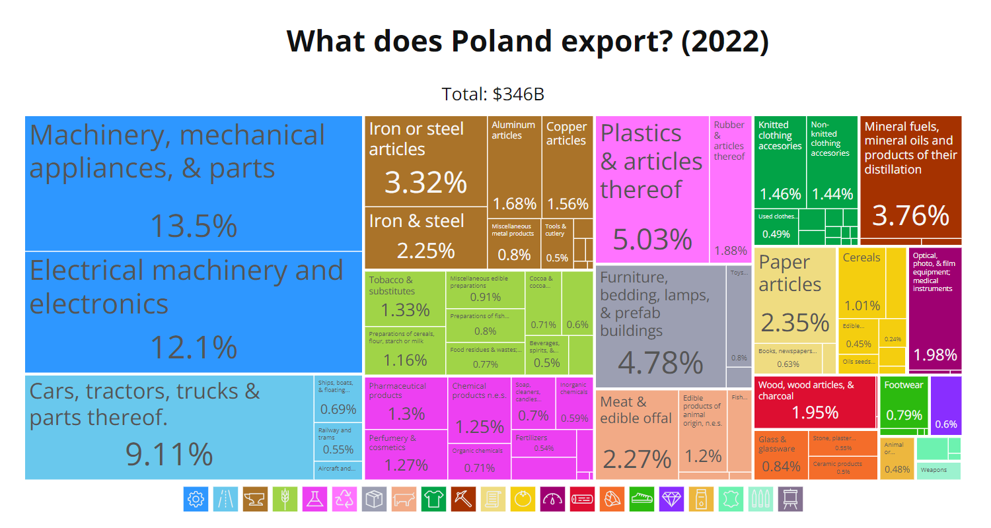

Slide 9
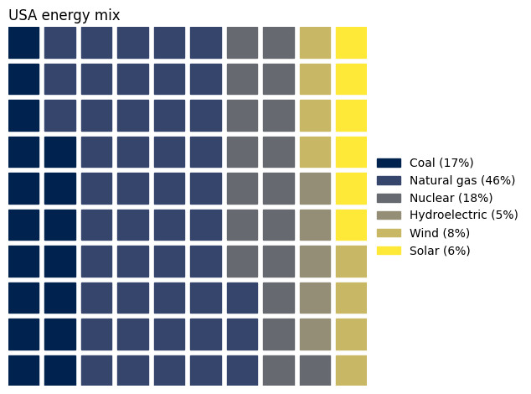
Waffle

Slide 10
Connections

Slide 11
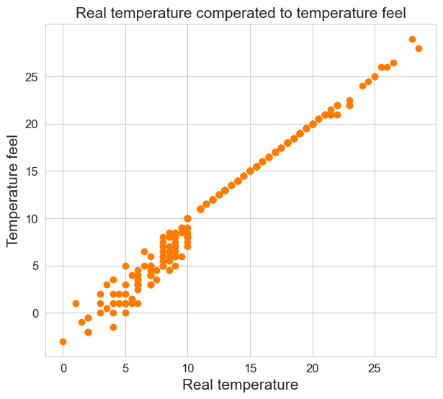
Scatter plot

Slide 12
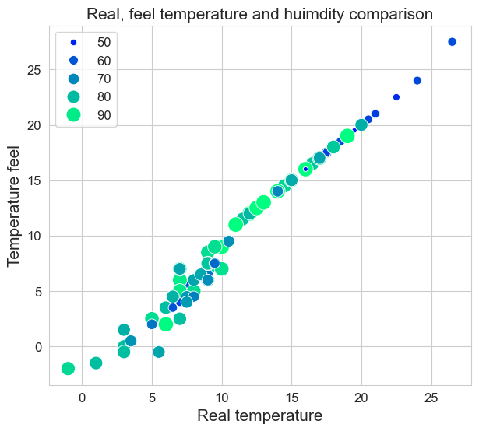
Bubble plot

Slide 13
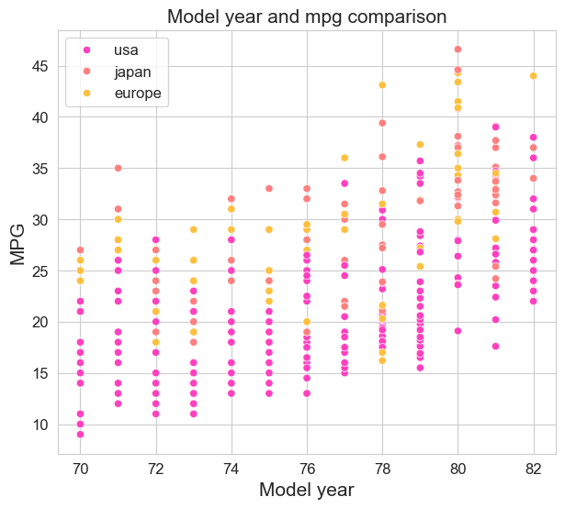
Jittering

Slide 14
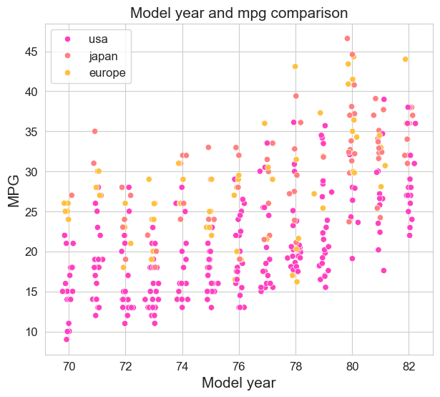
Jittering

Slide 15
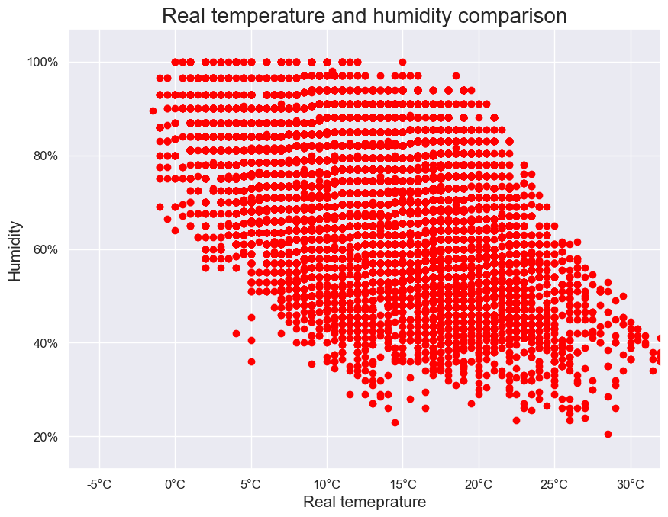
Overlapping points

Slide 16
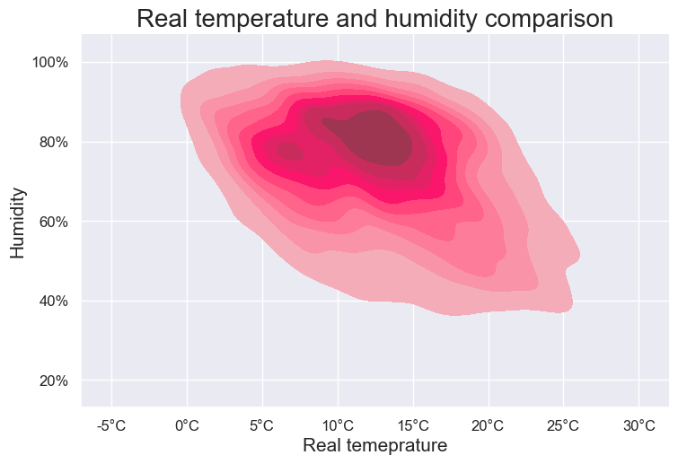
2D density graph

Slide 17
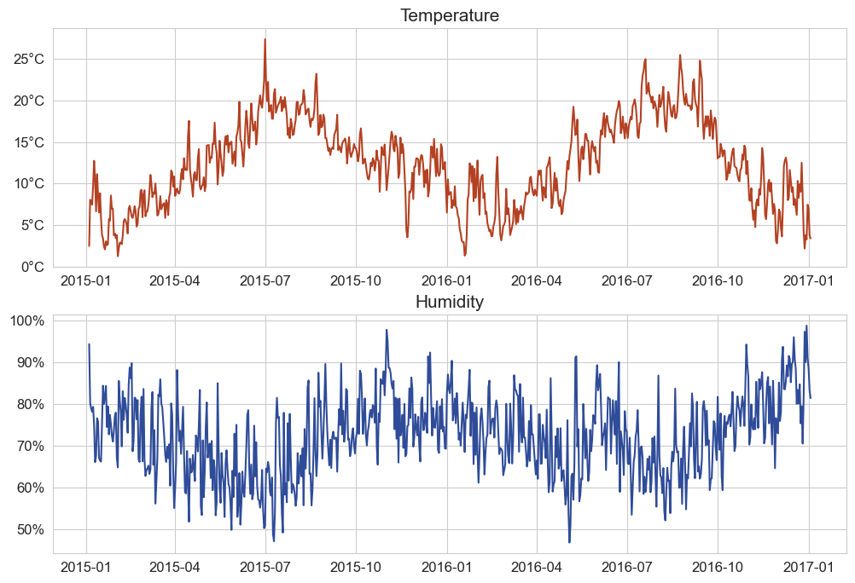
Line graph

Slide 18
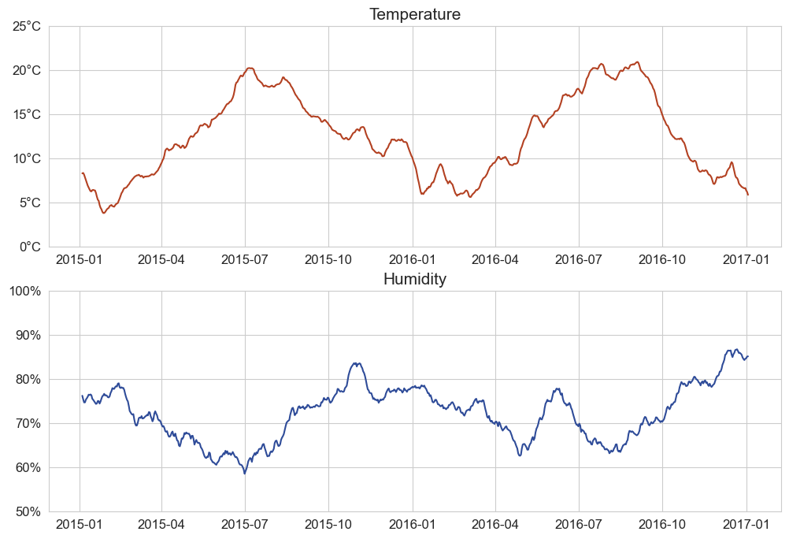
Line graph of data trend

Slide 19
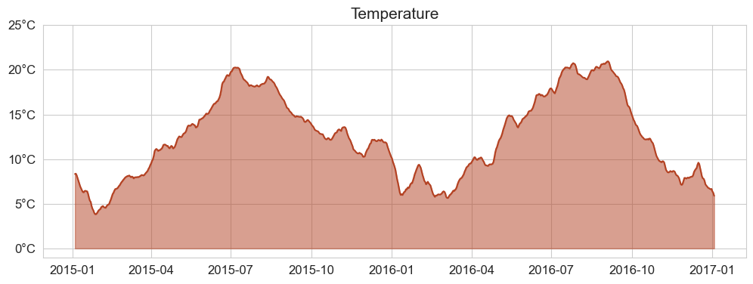
Area plot

Slide 20
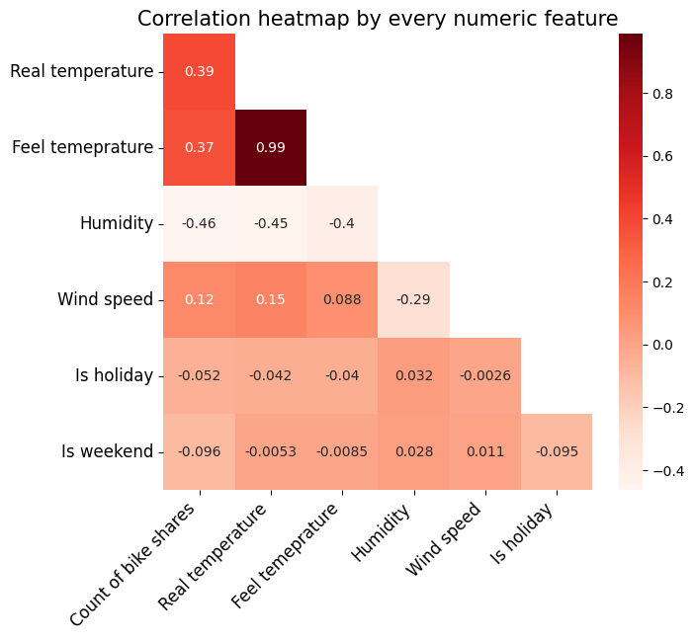
Heatmap for correlation

Slide 21
Dimensionality reduction
How many features We can fit on one graph
?

Slide 22
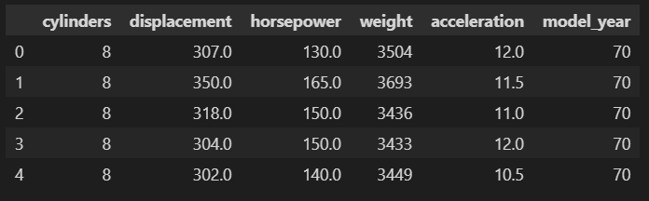
Dimensionality reduction

Slide 23
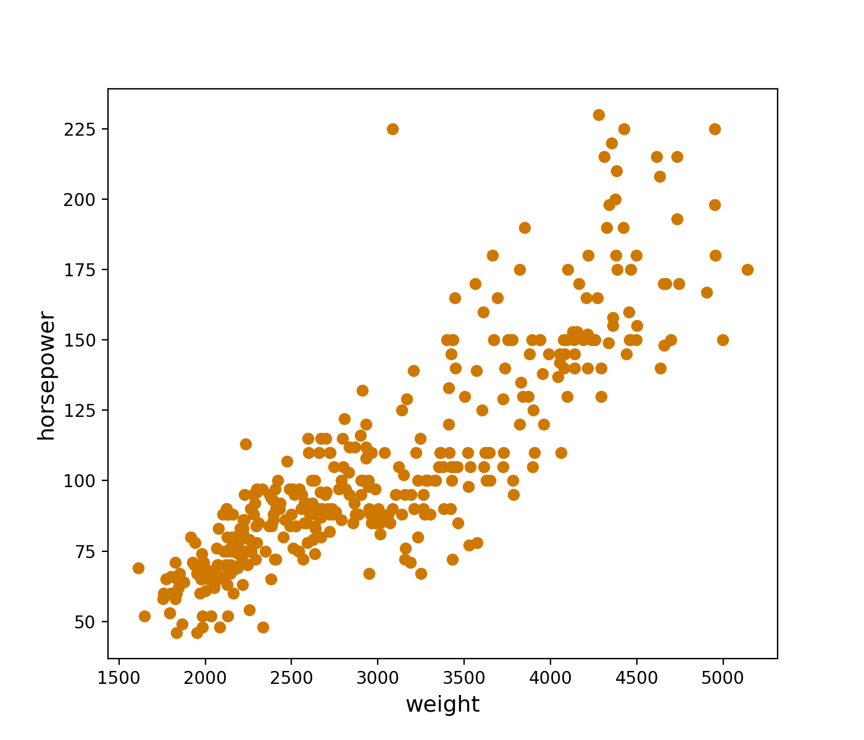
Dimensionality reduction

Slide 24
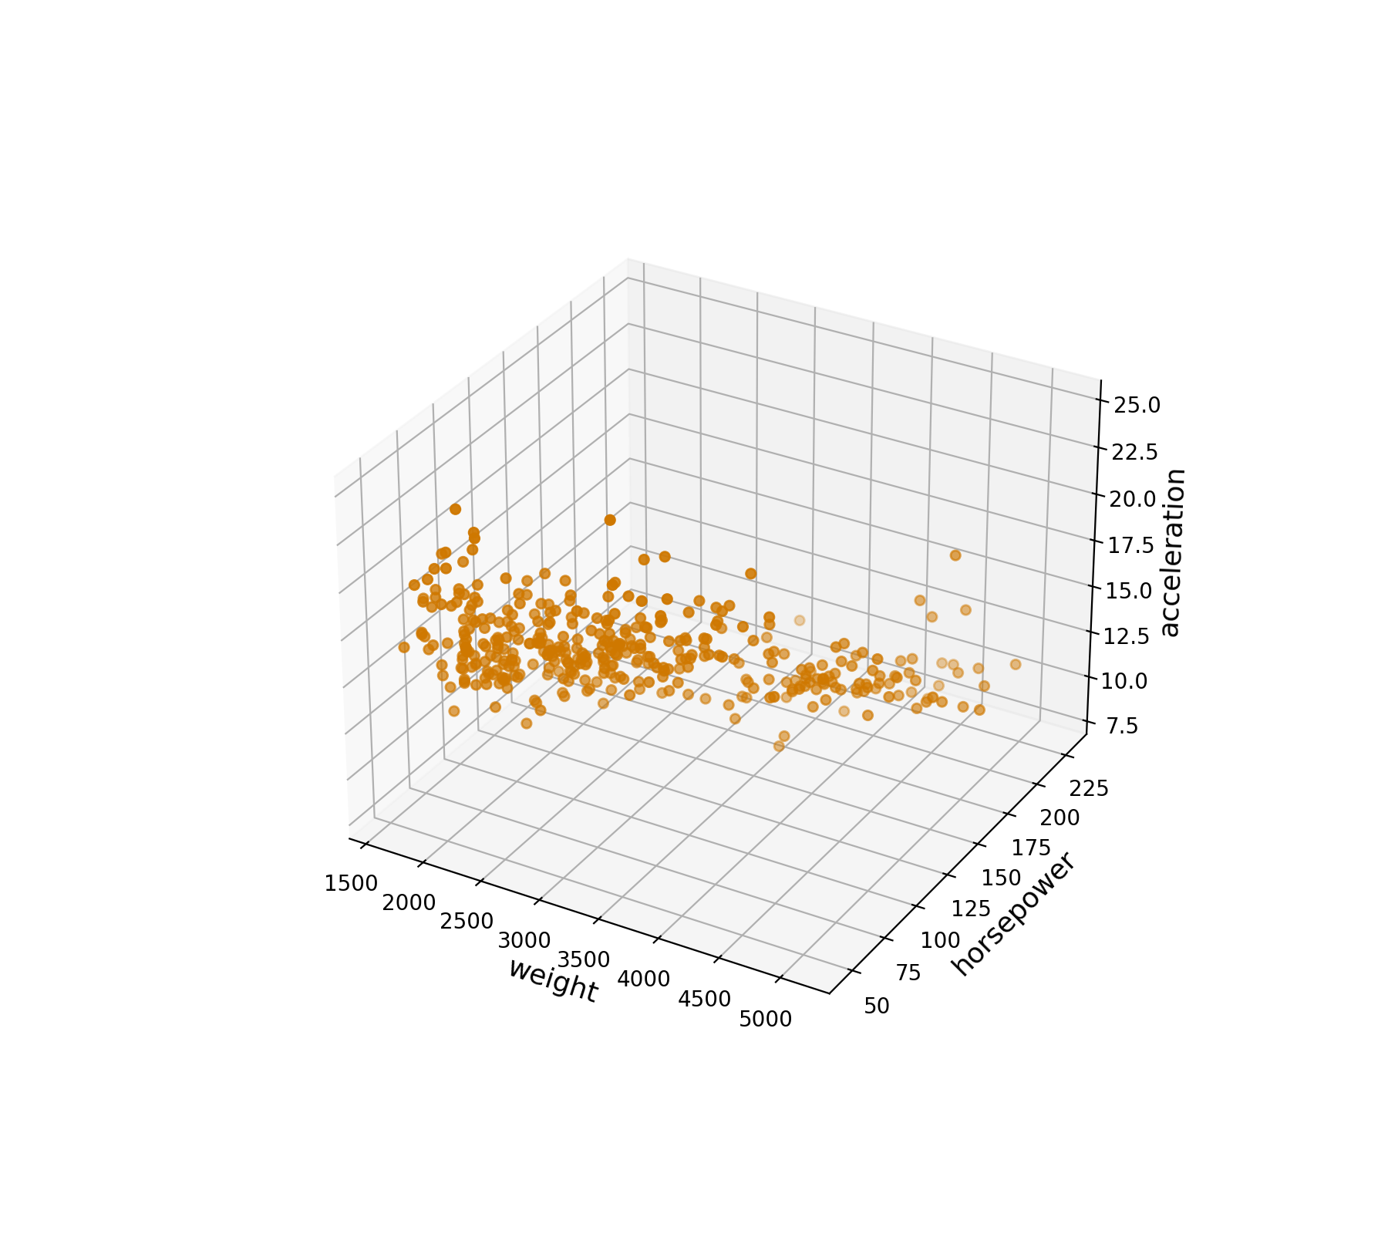
Dimensionality reduction

Slide 25
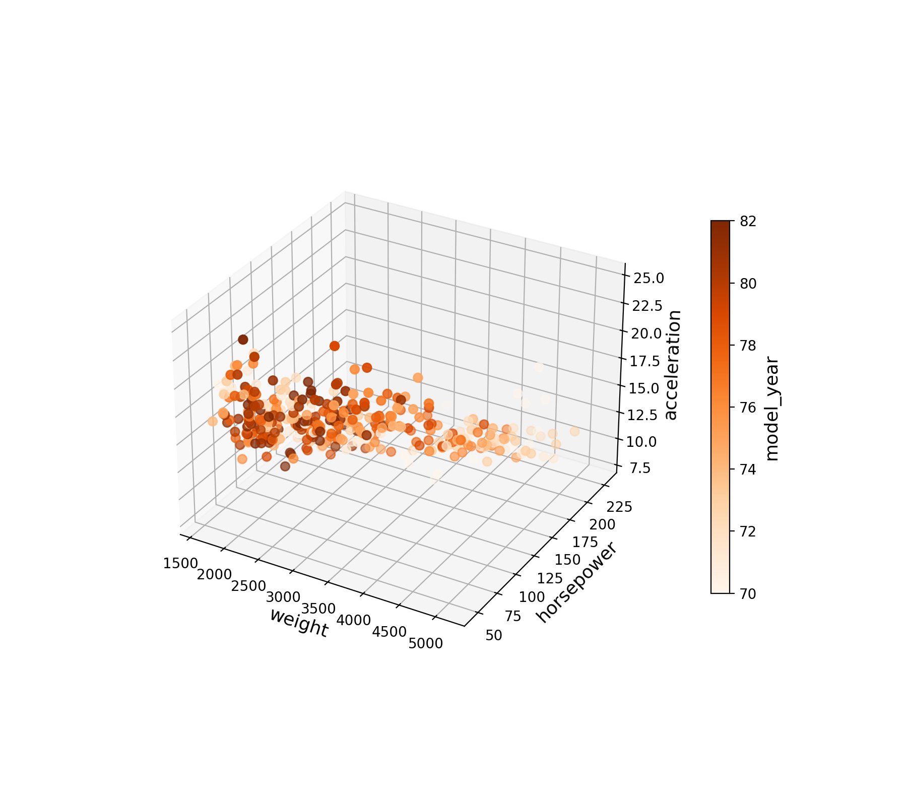
Dimensionality reduction

Slide 26
Principal component analysis

Slide 27
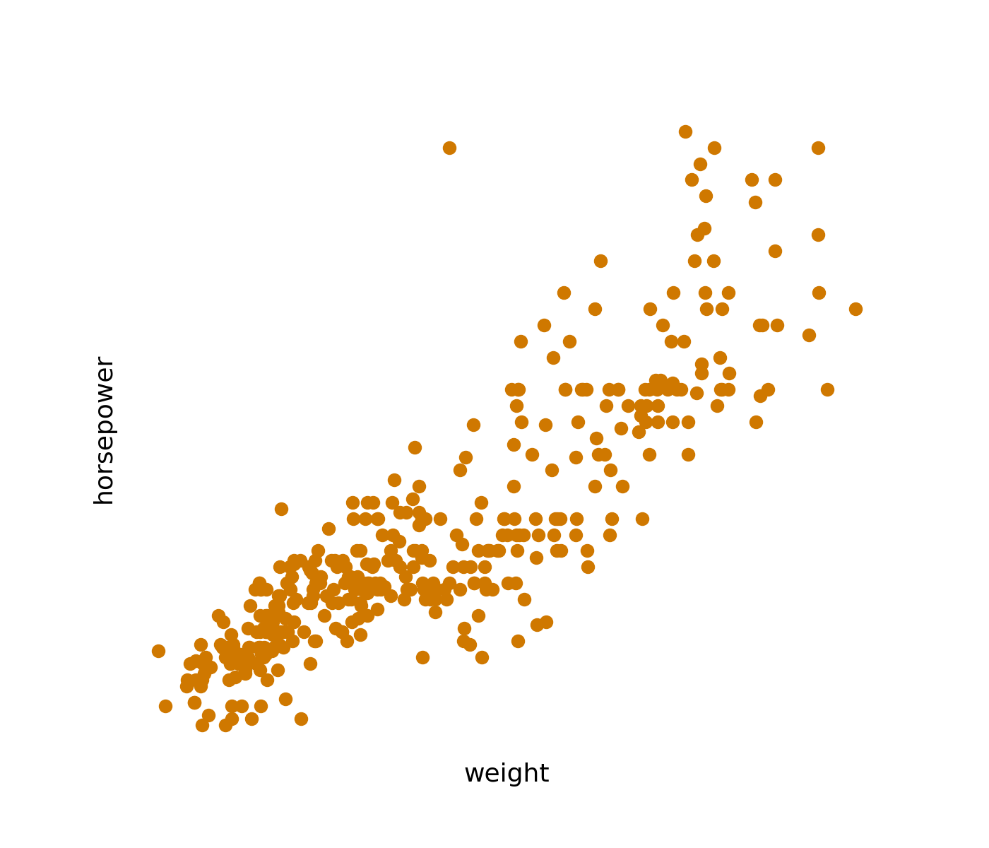
PCA

Slide 28
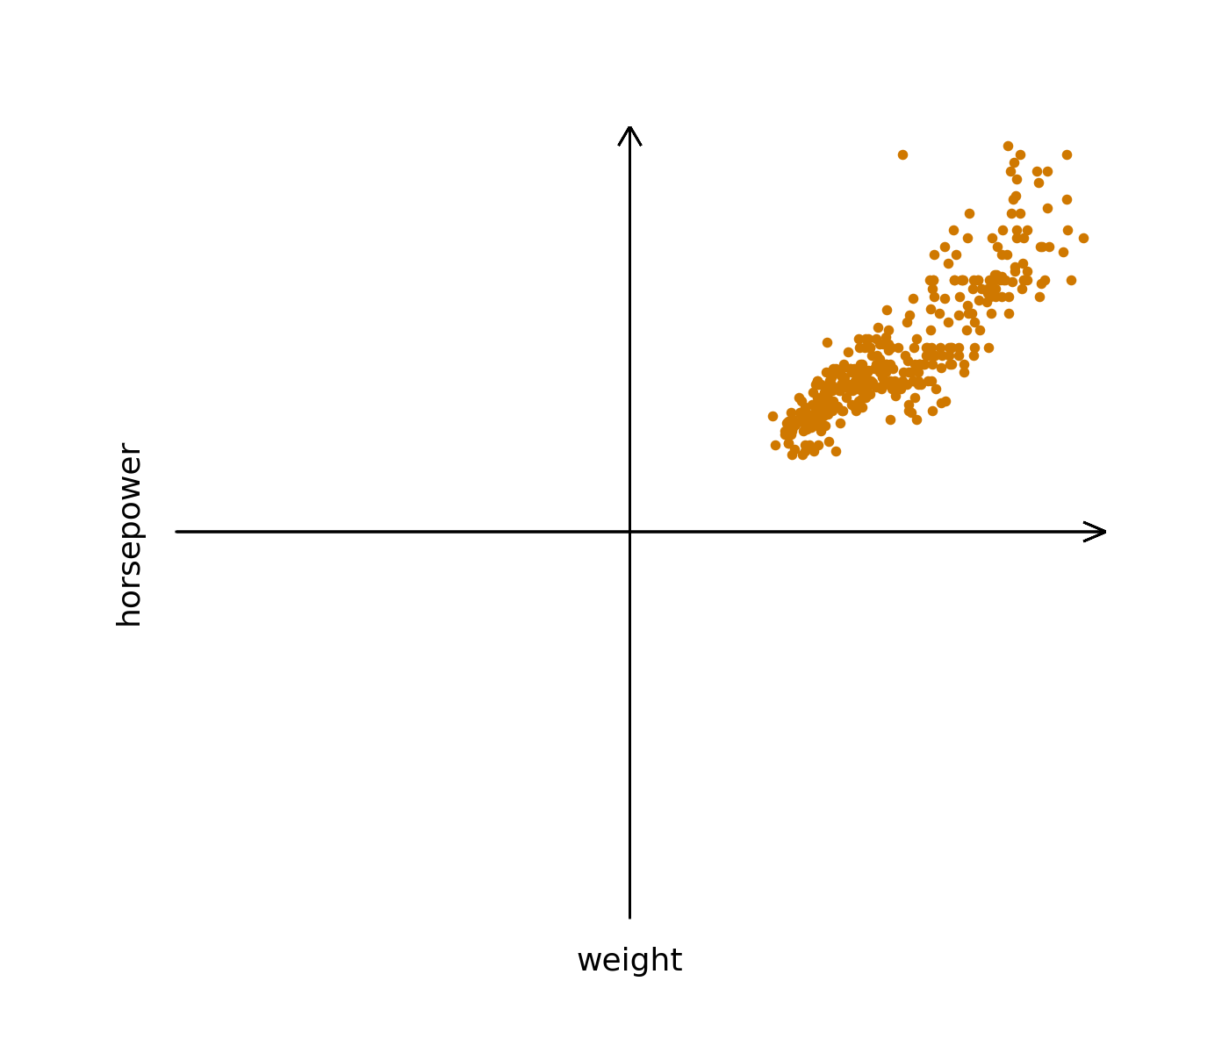
PCA

Slide 29

PCA

Slide 30
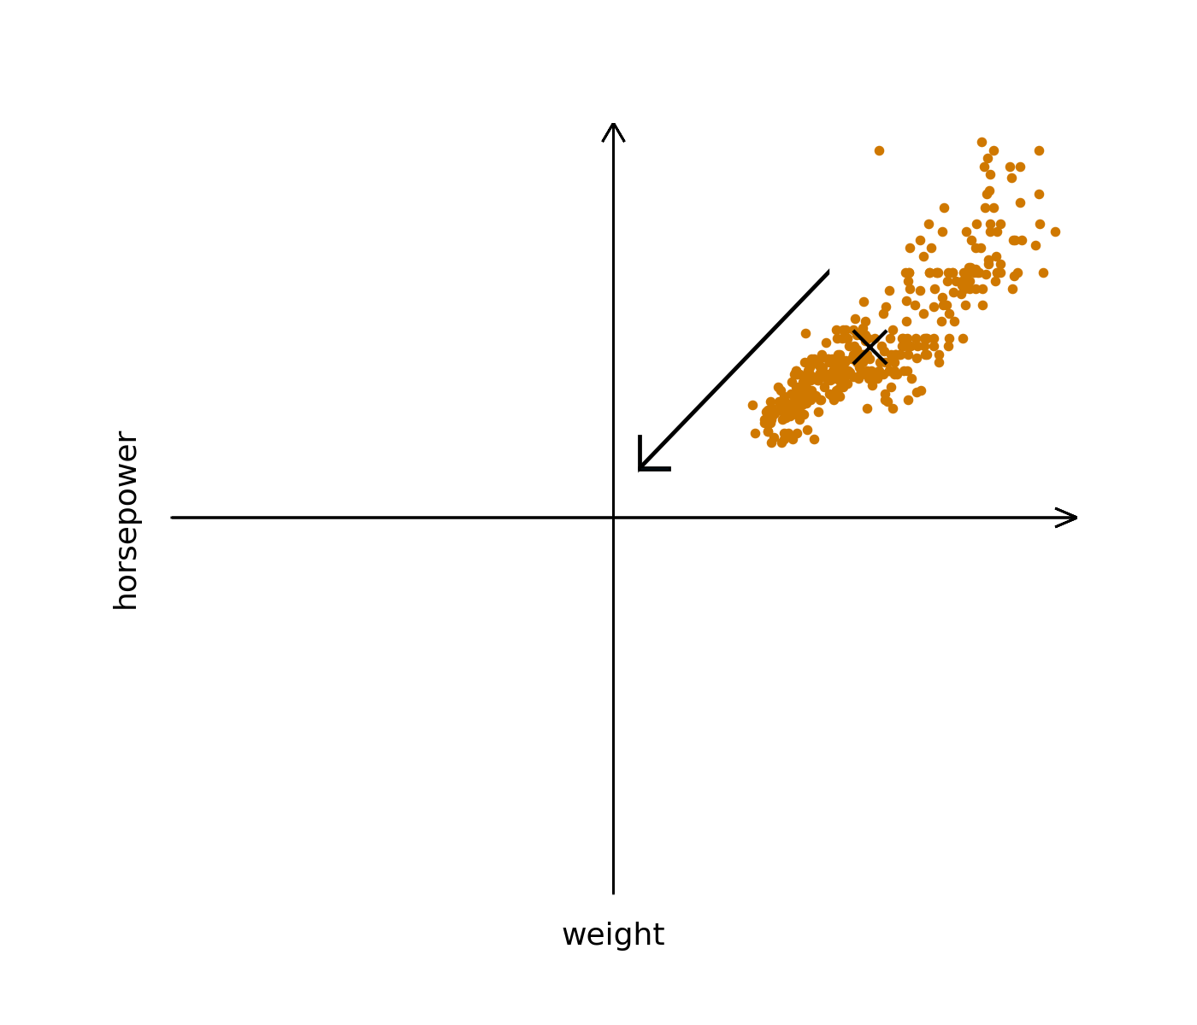
PCA

Slide 31
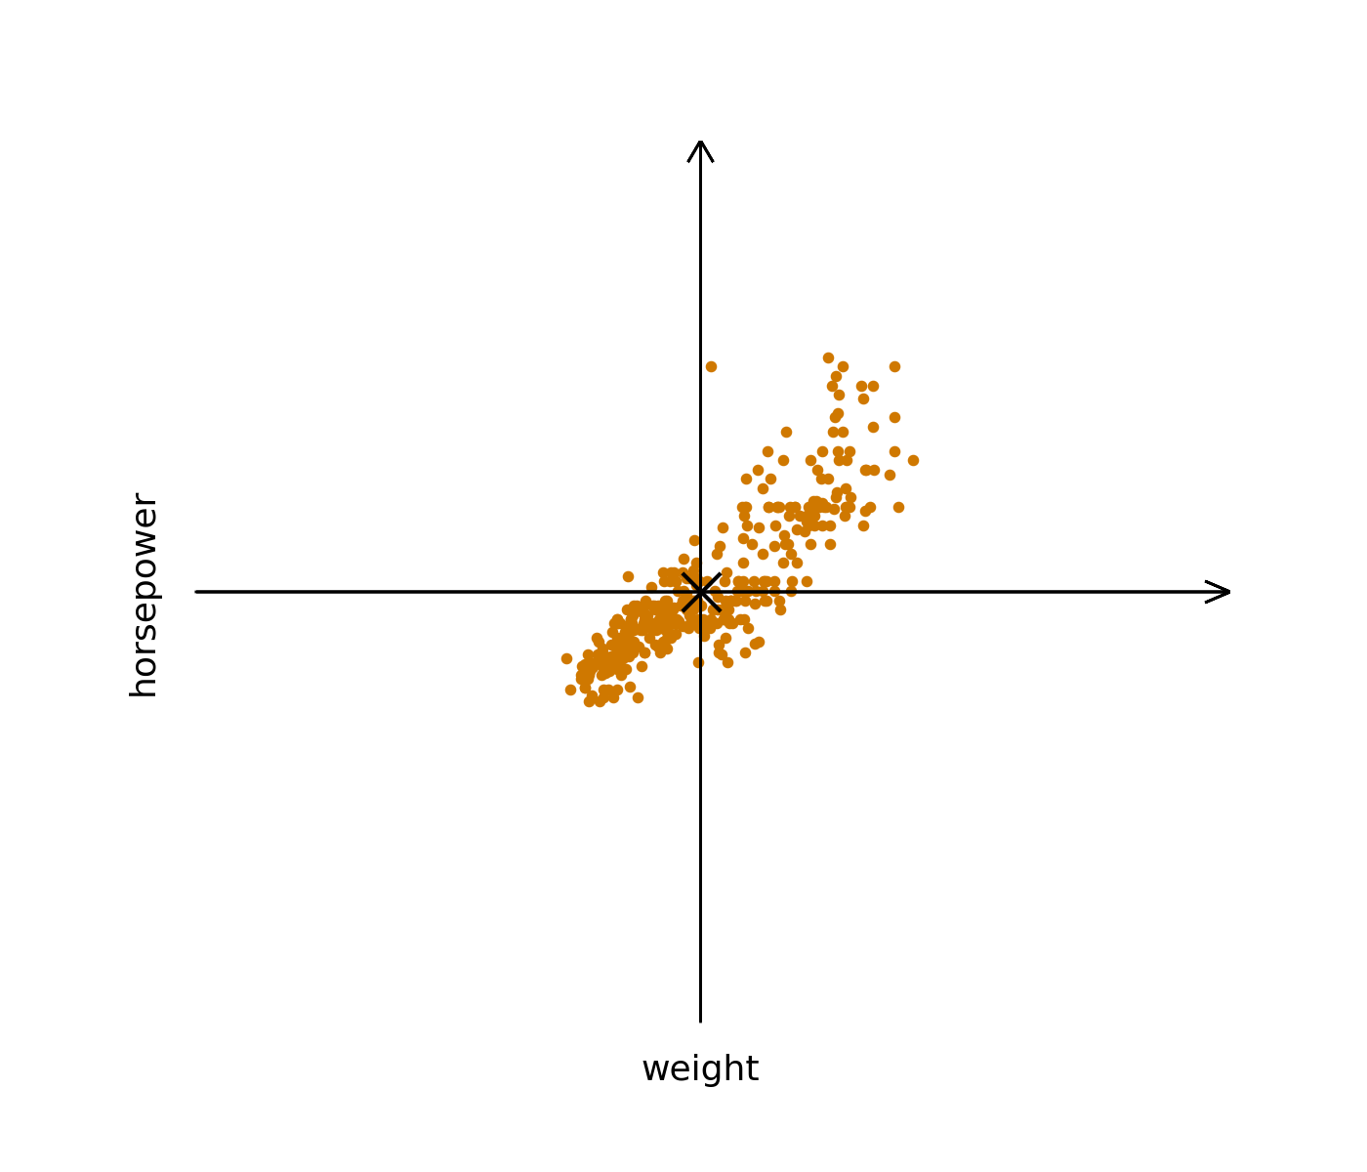
PCA

Slide 32
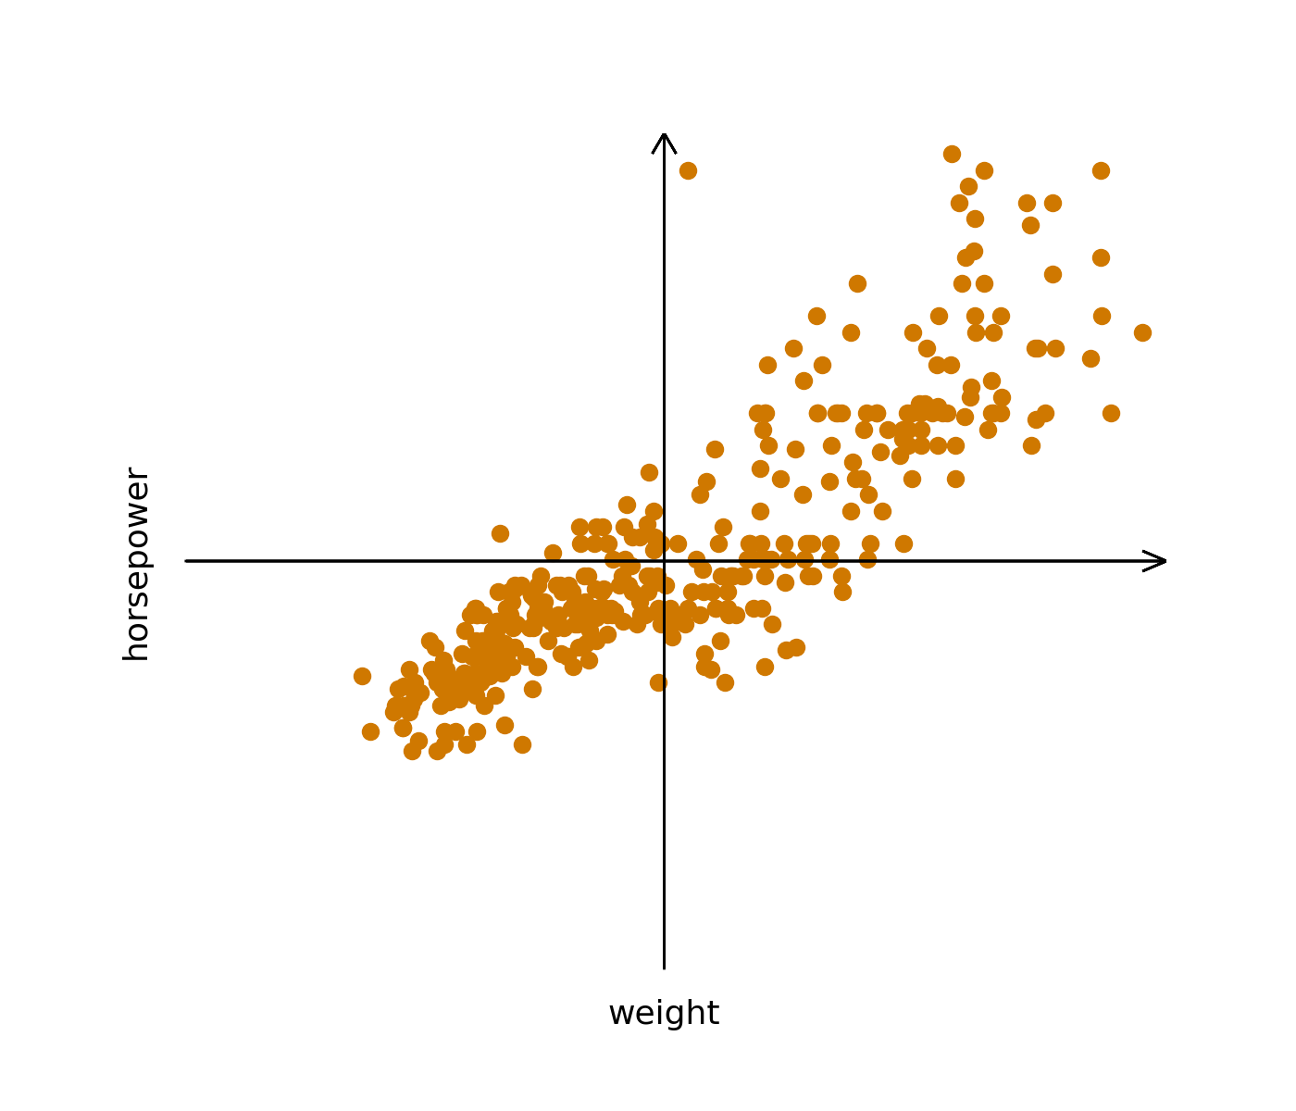
PCA

Slide 33
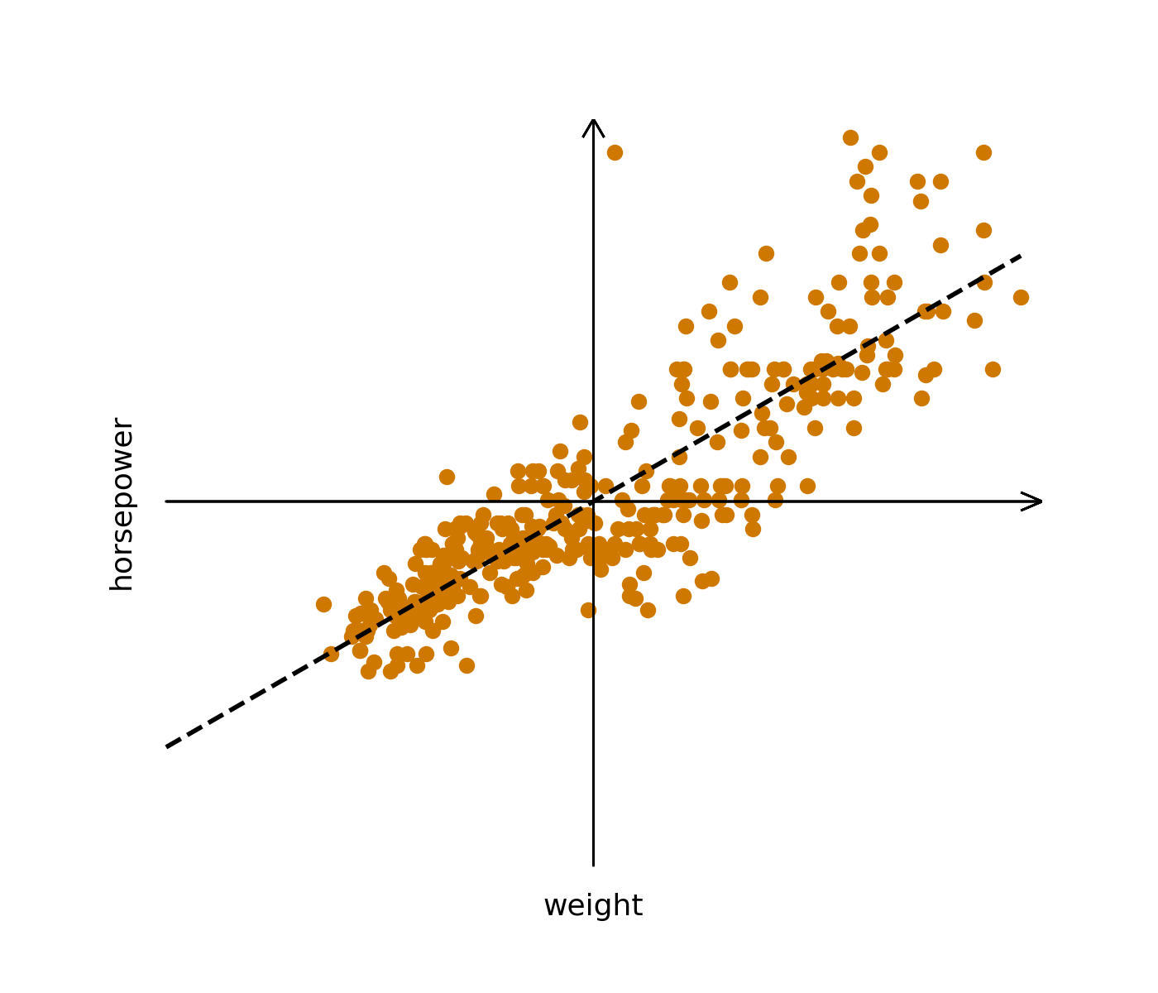
PCA

Slide 34
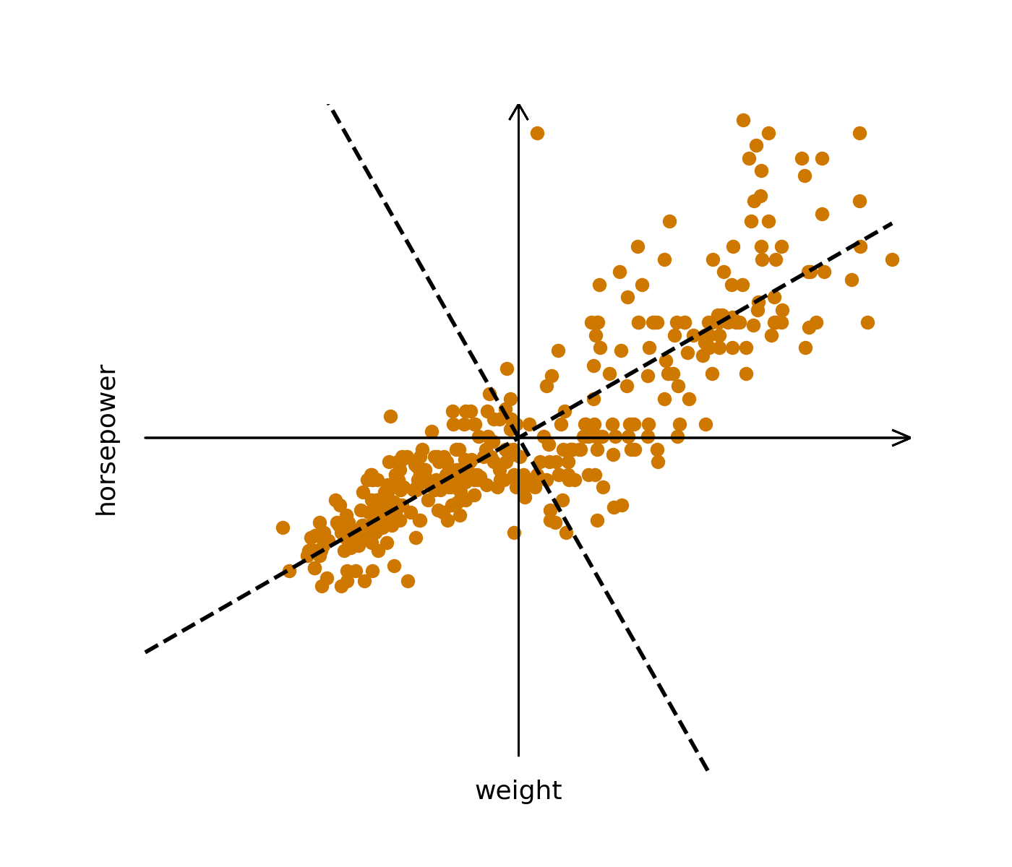
PCA

Slide 35

PCA

Slide 36
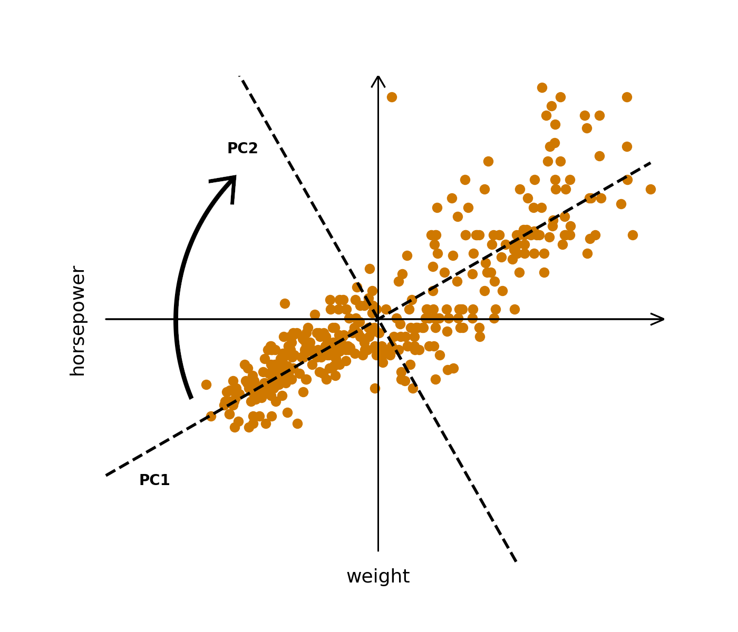
PCA

Slide 37
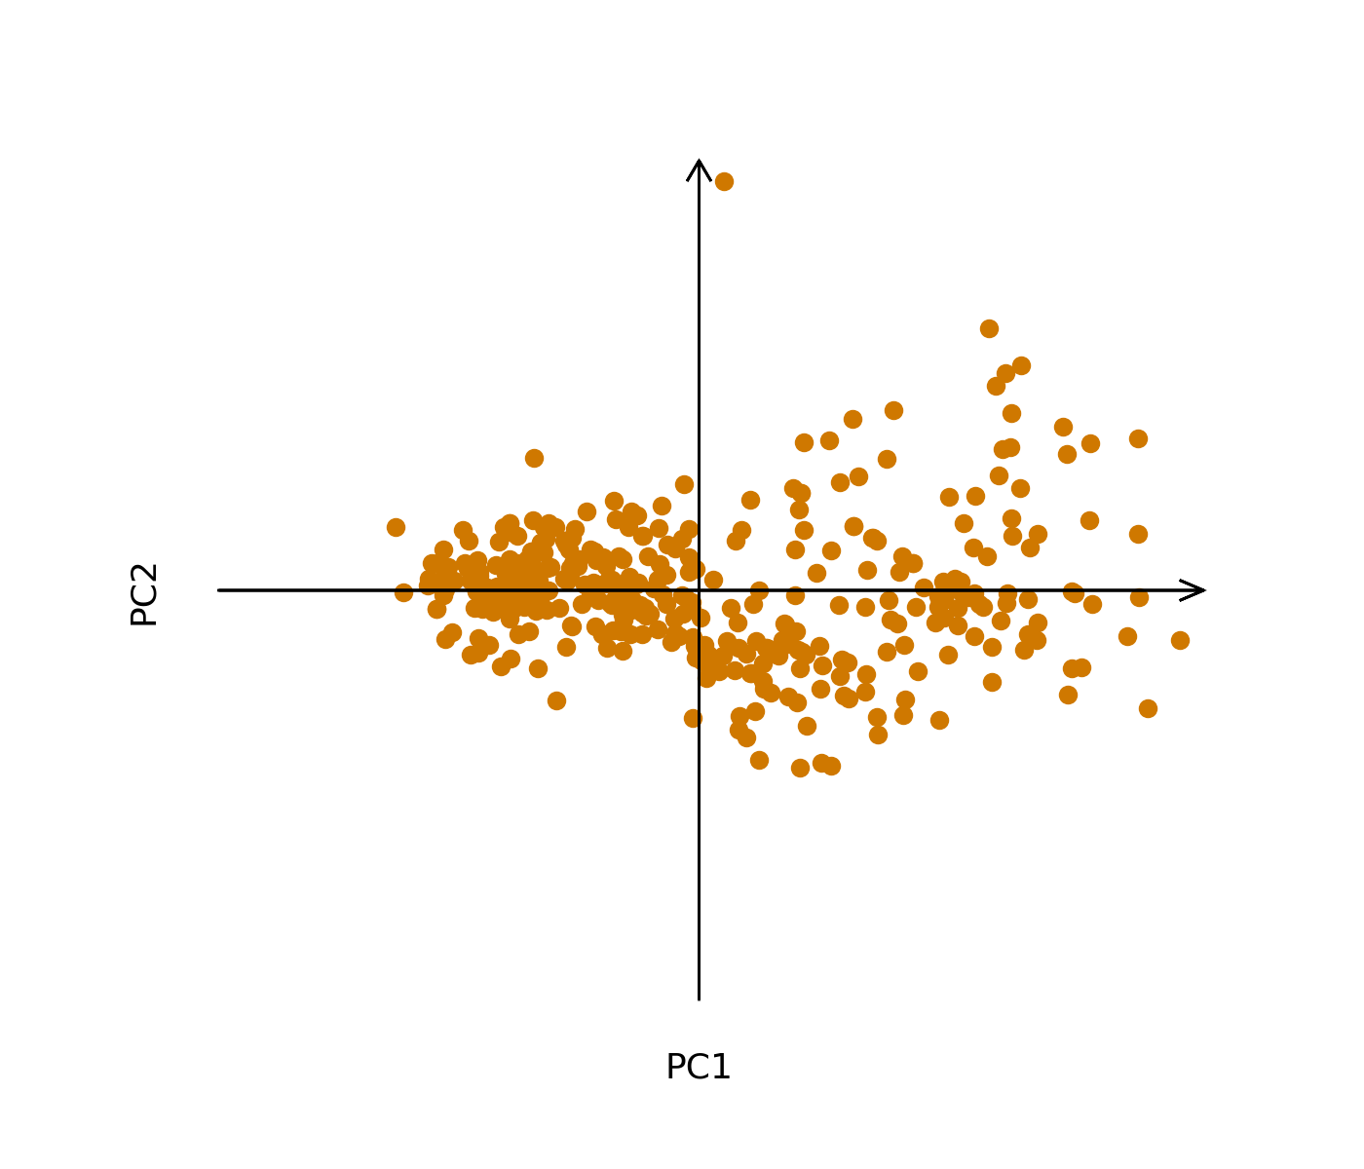
PCA

Slide 38
References
Information sources:
[1] Wes McKinney, Python for Data Analysis, 3E (2022), Wes’s Blog
[2] Claus O. Wilke, Fundamentals of Data Visualization (2019), Claus Website
Data sources:
[3] Sri Harsha Eedala, Electricity Generated in US by Sector (2023), Kaggle
[4] Hristo Mavrodiev, London bike sharing dataset (2019), Kaggle
Other:
[5] My private notes about data visualization an examples
Presentation author: Maksymilian Norkiewicz

